Slide 1
GPGPU: General Purpose GPU (aka “compute”)
Using the GPU to do non-graphical, massively parallel, programmable things
Uses the same hardware as the other shaders
Historically, specific vertex and fragment/pixel shaders gave way to programmable, then generally programmable shaders.
Fixed function, then…
Dedicated function, but somewhat programmable, then…
Generally programmable: any “shader” hardware could be any shader
i.e. you didn’t have “X vertex shaders and Y fragment shaders”, you had however many shaders you might need of whatever type you might need.

Slide 2
GPGPU: General Purpose GPU (aka “compute”)
If you consider that vertex, geometry, and fragment/pixel shaders basically take a buffer of information and convert it…
Vertex buffer
Vertex shader
Transformed vertices
Vertex & shape info
Geometry shader
(usually more)
Vertex & shape info
Transformed vertices + textures, etc.
Fragment shader
Pixel colours

Slide 3
GPGPU: General Purpose GPU (aka “compute”)
…then a shader is just something that transforms data from one format to another (as long as the data is mostly independent)
Note the similarity to one Mike Acton’s “3 lies”:
that “Code is more important than data”, when it’s really the opposite:
We want the data to be changed from this to that using a program.
Buffer of data
Any Shader
Changed buffer of data

Slide 4
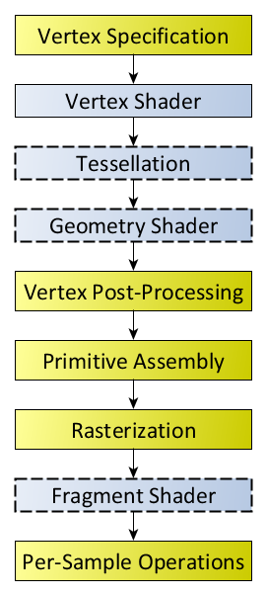
OpenGL Compute shader
Buffer of data
(texture, buffer, storage blocks, etc.)
Compute shader
Buffer of data
(texture, buffer, etc.)
The compute shader does this.
It’s completely separate and independent from the rendering pipeline. (image is from the Khronos site: note there’s no “compute”)

Slide 5
Draw vs Dispatch
Usually, we call a “Draw” to get things going.
Since we aren’t “drawing” anything, we use “Dispatch”
Specifically “DispatchCompute()”
We can bind to the shader with glUseProgram() like before (or with glBindProgramPipeline() which explicitly adds it)
DispatchCompute() takes three parameters, the number of “groups” in the x, y, and z dimensions.

Slide 6
Workgroups
void glDispatchCompute( GLuint num_groups_x, GLuint num_groups_y, GLuint num_groups_z);
These “dimensions” have absolutely nothing to do with the 3D drawing dimensions; they are just there to help you determine the ID of each instance of the compute shader thread.
You can use them to determine where to get the information, though, through the built-in variables…

Slide 7
Workgroups
void glDispatchCompute( GLuint num_x, GLuint num_y, GLuint num_z);
For example, let’s say you have a 1D array of data that’s 1,000 units long. You could call glDispatchCompute( 1000, 1, 1)
Inside the shader, the gl_WordGroupID has an x,y,z value indicating which “instance” or “invocation ID” of the shader this is.
i.e. the values of x would range from 0 to 999 while y and z would be 0
You could use this value as an index into the 1D array, if you wanted.
in uvec3 gl_NumWorkGroups;
in uvec3 gl_WorkGroupID;
in uvec3 gl_LocalInvocationID;
in uvec3 gl_GlobalInvocationID;
in uint gl_LocalInvocationIndex;

Slide 8
Workgroups
void glDispatchCompute( GLuint num_x, GLuint num_y, GLuint num_z);
If it was a 2D buffer, like say a texture, then you could pass the width and height of the texture:
glDispatchCompute( 2048, 1024, 1)
The gl_WorkGroup.x would range from 0 to 2,049 and gl_WorkGroup.y would range from 0 to 1,023
i.e. you could use these values as the pixel index of the 2D image
in uvec3 gl_NumWorkGroups;
in uvec3 gl_WorkGroupID;
in uvec3 gl_LocalInvocationID;
in uvec3 gl_GlobalInvocationID;
in uint gl_LocalInvocationIndex;

Slide 9
Workgroups
Hold on, Feeney! That’s nonsense!
The texture samplers don’t use pixels, they use a floating point range from 0 to 1.0!!!!
void glDispatchCompute( GLuint num_x, GLuint num_y, GLuint num_z);
If it was a 2D buffer, like say a texture, then you could pass the width and height of the texture:
glDispatchCompute( 2048, 1024, 1)
The gl_WorkGroup.x would range from 0 to 2,049 and gl_WorkGroup.y would range from 0 to 1,023
i.e. you could use these values as the pixel index of the 2D image
in uvec3 gl_NumWorkGroups;
in uvec3 gl_WorkGroupID;
in uvec3 gl_LocalInvocationID;
in uvec3 gl_GlobalInvocationID;
in uint gl_LocalInvocationIndex;

Slide 10
Workgroups
void glDispatchCompute( GLuint num_x, GLuint num_y, GLuint num_z);
Yes, and that’s what the gl_NumWorkGroups is for:
The 0.0f to 1.0f range can be determined by dividing the gl_WorkGroupID by the gl_NumWorkGroups: float u = gl_WorkGroupID.x / gl_NumWorkGroups.x; float v = gl_WorlkGroupID.y / gl_NumWorkGroups.y; vec4 theData = texture( sampler2DID, vec2(u, v) );
in uvec3 gl_NumWorkGroups;
in uvec3 gl_WorkGroupID;
in uvec3 gl_LocalInvocationID;
in uvec3 gl_GlobalInvocationID;
in uint gl_LocalInvocationIndex;

Slide 11
Workgroups
The other items are similar helpful values, too:
void glDispatchCompute( GLuint num_x, GLuint num_y, GLuint num_z);
in uvec3 gl_NumWorkGroups;
in uvec3 gl_WorkGroupID;
in uvec3 gl_LocalInvocationID;
in uvec3 gl_GlobalInvocationID;
in uint gl_LocalInvocationIndex;
Invocation ID in the local group
Global ID within ALL threads in this Dispatch call
Is: gl_WorkGroupID * gl_WorkGroupSize + gl_LocalInvocationID;
1D helper value for the invocation ID within this workgroup.
Is: gl_LocalInvocationIndex =
gl_LocalInvocationID.z * gl_WorkGroupSize.x * gl_WorkGroupSize.y +
gl_LocalInvocationID.y * gl_WorkGroupSize.x +
gl_LocalInvocationID.x;

Slide 12
Limits on workgroups
void glDispatchCompute( GLuint num_groups_x, GLuint num_groups_y, GLuint num_groups_z);
You can’t call any value on Dispatch, like you can’t call: glDispatchCompute( 1,000,000,000, 1, 1 )
GL_MAX_COMPUTE_WORK_GROUP_INVOCATIONS:
data returns one value, the number of invocations in a single local work group (i.e., the product of the three dimensions) that may be dispatched to a compute shader.
GL_MAX_COMPUTE_WORK_GROUP_COUNT:
Accepted by the indexed versions of glGet. data the maximum number of work groups that may be dispatched to a compute shader. Indices 0, 1, and 2 correspond to the X, Y and Z dimensions, respectively.
Note: You call glGetIntegeri_v() passing an array of 3 integers
GLint maxComputeWorkGroupCount[3] = {0};
glGetIntegeri_v(GL_MAX_COMPUTE_WORK_GROUP_COUNT, maxComputeWorkGroupCount)
GL_MAX_COMPUTE_WORK_GROUP_SIZE:
Accepted by the indexed versions of glGet. data the maximum size of a work groups that may be used during compilation of a compute shader. Indices 0, 1, and 2 correspond to the X, Y and Z dimensions, respectively.

Slide 13
Workgroups & invocation IDs
void glDispatchCompute( GLuint num_groups_x, GLuint num_groups_y, GLuint num_groups_z);
So the number of groups is really just to help you manage what it is that you are trying to do, rather than some visualization or requirement of the 3D space or something.
Like you can completely ignore all those built in variables if you want, or you can perform your own calculations internally:
If it was a 2D image, you can still pass a 1D index
You could pass a 3D grid of, say AABB information as a 1D value that represents the total size of the 3D (as a 1D array: which all 3D arrays really are – the computers memory is a giant 1D array, after all…)

Slide 14
Number of threads/call
AMD and nVidia will always dispatch way more than one instance of a shader -> these are called “warps” and “wavefronts” because… that sounds cool.
For nVidia, the minimum number is 64.
For AMD, it’s 32
This means that even if you call glDispatchCompute(1, 1, 1), you will get 32 or 64 instances – but only one will be of any use, I suppose.
So you should consider calling Dispatch with multiples of 64

Slide 15
Synchronizations and barriers
There are ways to synchronize compute instances.
Think “wait for multiple objects” or a critical section lock
But that’s usually not what the compute is for.
A barrier() in GLSL will stop the shader until the other instances reach it, and there are atomic (think interlock-exchange or locks) functions that allow uniforms/buffer data to be read/written by only one instance at a time.
However, you might consider ways to not do this, just to get your head around just how massive the threading is.
i.e. think about copying one buffer to another buffer, rather than typical single threaded sort of algorithms/techniques

Slide 16
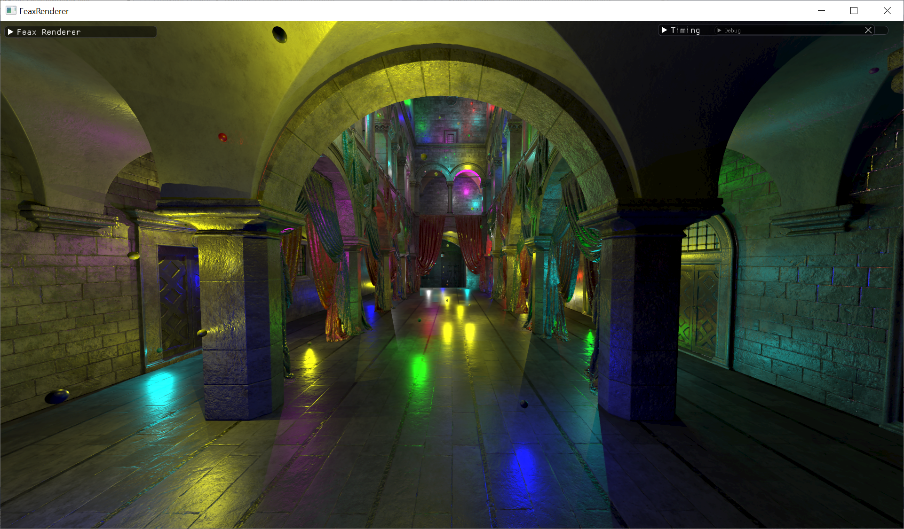

Slide 17
Lots of lights, say 1,000 lights.
We have an array of lights
vec3 position[1,000]
Passed as a uniform or a buffer…
The compute knows that there’s 1000
Can go through a loop of all the lights from index 0 to 999
BUT, in the 1st pass of the deferred, we have multiple layers of the FBO (normal, world position, whatever)
Let’s just consider the vertex world position.
Remember this is a 2D texture (the FBO being 2D) and its height and width are the size of the FBO not the vertex position.

Slide 18
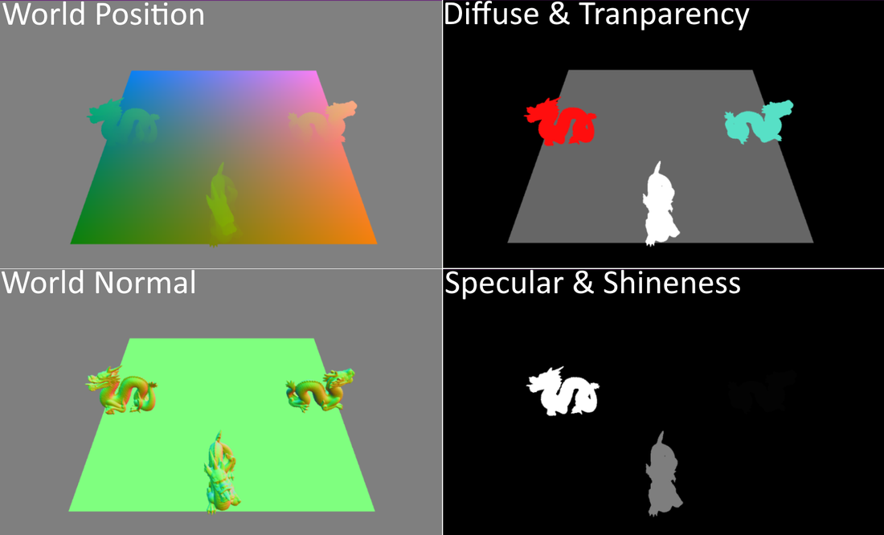
Recall with referred, you get something like this:
When you call the fragment shader, you are only looking at the location in the FBO textures by using the gl_FragCoord values.
You then calculate the lighting by sampling the same FragCoord from all the textures
Remember that the lighting calculation is still pulling the light data from the uniform light values, like: sLight theLights[NUMBEROFLIGHTS];

Slide 19
Lots of lights, say 1,000 lights.
We have an array of lights
vec3 lightPosition[1,000]
We can use the FragCoord to determine where we are in the scene, but then go through just the light positions (in that 1D array) and output a bunch of indices matching the “closest” lights.
Let’s say:
The FBO is a 2D texture with vec4s – indicating the vertex world position
The output is also a 2D texture with vec4s (say), BUT these 4 values are the light index from the lightPosition array above
They take in all 1000 light positions, and output only the “closest 4” values.
Then the next pass (the fragment shader) reads the output from the compute and uses those 4 indices to lookup the 4 closest lights.

Slide 20
Getting data into and out of the compute
Can use a “texture” or a buffer, but let’s use an example that’s a combination of the LearnOpenGL site (a great site) and the TextureManager/loader thing in the example code.
The example code takes a 24 bit bitmap, where each RGB is 8 bits:
CTextureFromBMP.cpp around line 550:
//uchar redPixel; ← C24BitBMPpixel
//uchar greenPixel;
//uchar bluePixel;
this->m_p_theImages = new C24BitBMPpixel[this->m_numberOfColumns * this->m_numberOfRows];
Allocates a 1D array of three bytes, with a stride of 3 bytes per index.

Slide 21
Getting data into and out of the compute
Assuming this->m_p_theImages is this array (RGB, 8 bits each)
Around line 99 we see this:
glGenTextures( 1, &(this->m_textureNumber) );
glBindTexture(GL_TEXTURE_2D, this->m_textureNumber);
glTexImage2D( GL_TEXTURE_2D,// target (2D, 3D, etc 0,// MIP map level GL_RGBA,// internal format i.e. in the GPU this->m_numberOfColumns,// width (pixels) this->m_numberOfRows,// height (pixels) 0,// border (0 or 1) GL_RGB,// format of pixel data ← that the GPU is being given GL_UNSIGNED_BYTE,// type of pixel data this->m_p_theImages);// pointer to data in memory
https://registry.khronos.org/OpenGL-Refpages/gl4/html/glTexImage2D.xhtml

